Slide 1
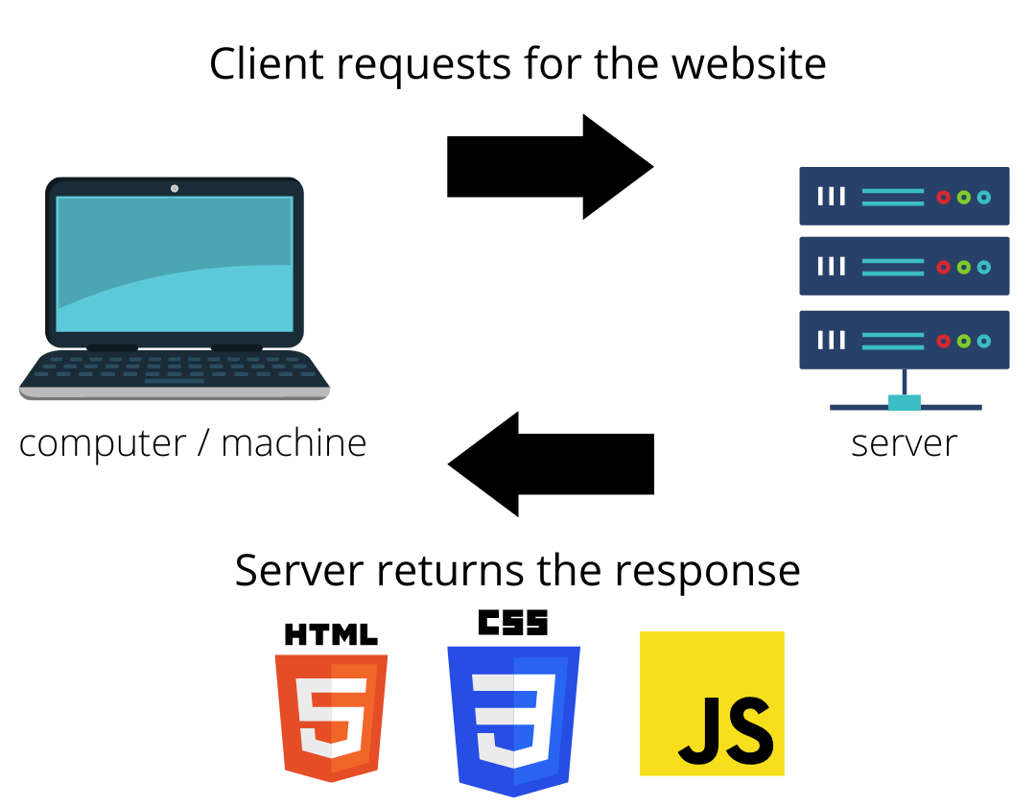
Clients and servers Computers connected to the internet are called clients and servers. A simplified diagram of how they interact might look like this:
How does the Web works?
Clients are the typical web user's internet-connected devices (for example, your computer connected to your Wi-Fi, or your phone connected to your mobile network) and web-accessing software available on those devices (usually a web browser like Firefox or Chrome).
Servers are computers that store webpages, sites, or apps. When a client device wants to access a webpage, a copy of the webpage is downloaded from the server onto the client machine to be displayed in the user's web browser.

Slide 2
What do you need to be a web developer? To become a Web Developer, you should have an understanding of HTML, CSS, and JavaScript. It’s also recommended to learn about CSS and CSS frameworks. Developing these fundamental web development skills will give you the foundation and logic for communicating with programming languages.
How to become a Web Developer in five steps:
Learn web development fundamentals
Choose a development specialization
Learn key programming languages for web development
Work on projects to develop your Web Developer skills
Build a web development portfolio

Slide 3
Learn web development fundamentals
Choose a development specialization
The best first step to becoming a Web Developer is to start learning web development fundamentals, including an understanding of HTML (Hypertext Markup Language), CSS (Cascading Style Sheets), and JavaScript.
As you continue to grow your skills, you’ll need to choose an area of specialization. But what are the types of web development?
Front-End Developer. A Front-End Developer works on the “client-side” of web development
Back-End Developer. A Back-End Developer works on the “server-side” of web development

Slide 4
Learn key programming languages for web development
Build Projects to Develop Your Web Developer Skills
Three families of programming languages form the basic tools involved in virtually all aspects of web development:
HTML (Hypertext Markup Language)
CSS (Cascading Style Sheets)
JavaScript
With a grasp of the basics in HTML, CSS, and JavaScript, and a foundation of programming skills, you’re ready to begin building. As you go, you’ll gain experience using an ever-growing set of Web Developer skills. Some of these are technical skills, or “hard” skills, like programming in SQL or Python, using the jQuery library of functions for more efficient programming, or using tools like Git for version control. The best way to improve these web development skills is simply to start messing around – the more you use them, the better you’ll be.
Build a web development portfolio
A riveting Web Developer portfolio that shows off your strongest skills is your best tool when applying for web development jobs

Slide 5
Why did you choose to learn web development?
Short education time
High creative potential
Ability to work in various work environments
Freelance opportunities
Career growth
Opportunity for innovation and invention
Chance to learn transferable skills

